Slide 1
Data Analytics (CS3203N)
Lecture #4
Programming with R

Slide 2


Quote of the day..
What we think, we become.
Gautama Buddha, Sege

Slide 3

Today’s discussion…
R is an open source programming language and software environment for statistical computing and graphics.
The R language is widely used among statisticians and data miners for developing statistical software and data analytics tools

Slide 4
History of R
Modelled after S & S-plus, developed at AT&T labs in late 1980s.
R project was started by Robert Gentleman and Ross Ihaka Department of Statistics, University of Auckland (1995).
Currently maintained by R core development team – an international team of volunteer developers (since 1997).

Slide 5
R resources
http://www.r-project.org/
http://cran.r-project.org/doc/contrib/Verzani-SimpleR.pdf

Slide 6
Download R and RStudio
Download R :
http://cran.r-project.org/bin/
Download RStudio :
http://www.rstudio.com/ide/download/desktop

Slide 7
Installation
Installing R on windows PC :
Use internet browser to point to : http://mirror.aarnet.edu.au/pub/CRAN
Under the heading Precompiled Binary Distributions, choose the link Windows.
Next heading is R for Windows; choose the link base.
Click on download option(R 3.4.1 for windows).
Save this to the folder C:\R on your PC.
When downloading is complete, close or minimize the Internet browser.
Double click on R 3.4.1-win32.exe in C:\R to install.
Installing R on Linux:
sudo apt-get install r-base-core

Slide 8
Installation
Installing RStudio:
Go to www.rstudio.com and click on the "Download RStudio" button.
Click on "Download RStudio Desktop.“
Click on the version recommended for your system, or the latest Windows version, and save the executable file. Run the .exe file and follow the installation instructions.

Slide 9
Version
Get R version
R.Version()
Get RStudio version
RStudio: Toolbar at top > Help > About RStudio

Slide 10
A test run with R in Windows
Double click the R icon on the Desktop and the R Console will open.
Wait while the program loads. You observe something like this.
You can type your own program at the prompt line >.

Slide 11
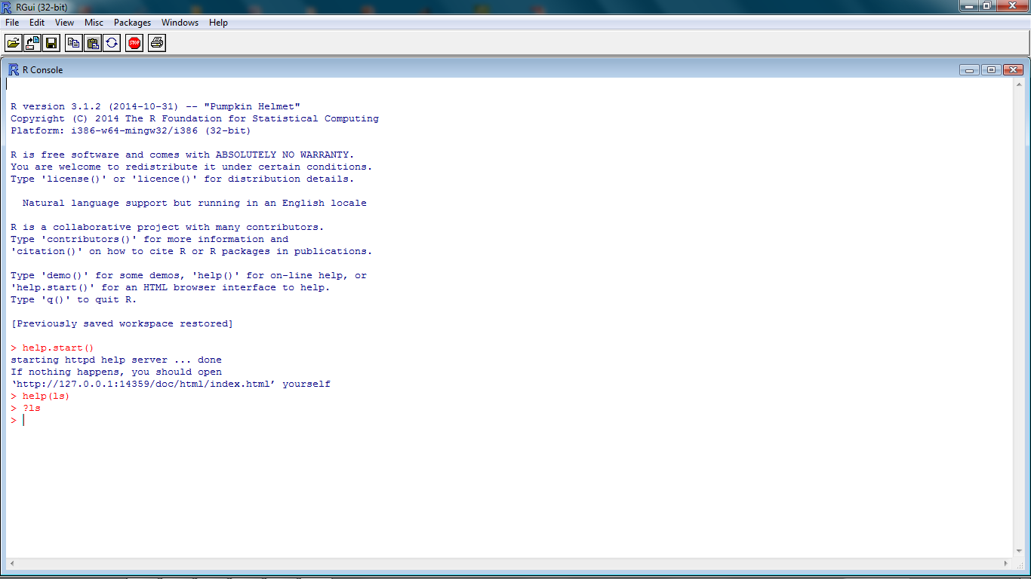
Getting help from R console
help.start()
help(topic)
?topic
??topic

Slide 12
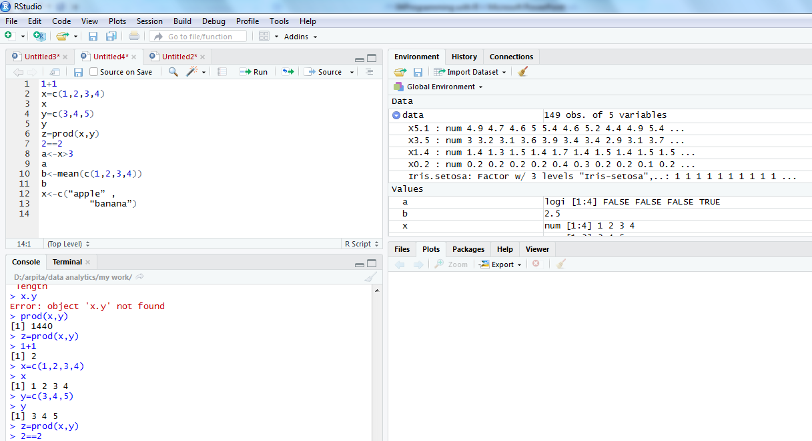
R command in integrated environment

Slide 13
How to use R for simple maths
> 3+5
> 12 + 3 / 4 – 5 + 3*8
> (12 + 3 / 4 – 5) + 3*8
> pi * 2^3 – sqrt(4)
>factorial(4)
>log(2,10)
>log(2, base=10)
>log10(2)
>log(2)
Note
R ignores spaces

Slide 14
How to store results of calculations for future use
> x = 3+5
> x
> y = 12 + 3 / 4 – 5 + 3*8
> y
> z = (12 + 3 / 4 – 5) + 3*8
> z
> A <- 6 + 8 ## no space should be between < & -
> a ## Note: R is case sensitive
>A

Slide 15
Identifiers naming
Don't use underscores ( _ ) or hyphens ( - ) in identifiers.
The preferred form for variable names is all lower case letters and words separated with dots (variable.name) but variableName is also accepted.
Examples: avg.clicks GOOD avgClicks OK avg_Clicks BAD
Function names have initial capital letters and no dots (e.g., FunctionName).

Slide 16
Using C command
> data1 = c(3, 6, 9, 12, 78, 34, 5, 7, 7) ## numerical data
> data1.text = c(‘Mon’, ‘Tue’, “Wed”) ## Text data
## Single or double quote both ok
##copy/paste into R console may not work
> data1.text = c(data1.text, ‘Thu’, ‘Fri’)

Slide 17
Scan command for making data
> data3 = scan() ## data separated by Space / Press
## Press Enter key twice to exit
1: 4 5 7 8
5: 2 9 4
8: 3
9:
> data3
[1] 4 5 7 8 2 9 4 3
## Read 8 items

Slide 18
Scan command for making data
> d3 = scan(what = ‘character’)
1: mon
2: tue
3: wed thu
5:
> d3
[1] "mon" "tue" "wed" "thu"
> d3[2]
[1] "tue"
> d3[2]='mon'
> d3
[1] "mon" "mon" "wed" "thu"
> d3[6]='sat'
> d3
[1] "mon" "mon" "wed" "thu" NA "sat"
> d3[2]='tue'
> d3[5] = 'fri'
> d3
[1] "mon" "tue" "wed" "thu" "fri" "sat"

Slide 19
Concept of working directory
>getwd()
[1] "C:\Users\DSamanta\R\Database"
> setwd('D:\Data Analytics\Project\Database)
> dir() ## working directory listing
>ls() ## Workspace listing of objects
>rm(‘object’) ## Remove an element “object”, if exist
> rm(list = ls()) ## Cleaning

Slide 20
Reading data from a data file
> setwd("D:/arpita/data analytics/my work") #Set the working directory to file location
> getwd()
[1] "D:/arpita/data analytics/my work“
> dir()
[1] "Arv.txt" "DiningAtSFO" "LatentView-DPL" "TC-10-Rec.csv" "TC.csv"
rm(list=ls(all=TRUE)) # Refresh session
> data=read.csv('iris.csv', header = T, sep=",")
(data = read.table(‘iris.csv', header = T, sep = ','))
> ls()
[1] "data"
> str(data)
'data.frame': 149 obs. of 5 variables:
$ X5.1 : num 4.9 4.7 4.6 5 5.4 4.6 5 4.4 4.9 5.4 ...
$ X3.5 : num 3 3.2 3.1 3.6 3.9 3.4 3.4 2.9 3.1 3.7 ...
$ X1.4 : num 1.4 1.3 1.5 1.4 1.7 1.4 1.5 1.4 1.5 1.5 ...
$ X0.2 : num 0.2 0.2 0.2 0.2 0.4 0.3 0.2 0.2 0.1 0.2 ...
$ Iris.setosa: Factor w/ 3 levels "Iris-setosa",..: 1 1 1 1 1 1 1 1 1 1 ...

Slide 21
Accessing elements from a file
> data$X5.1
[1] 4.9 4.7 4.6 5.0 5.4 4.6 5.0 4.4 4.9 5.4 4.8 4.8 4.3 5.8 5.7
> data$X5.1[7]=5.2
> data$X5.1
[1] 4.9 4.7 4.6 5.0 5.4 4.6 5.2 4.4 4.9 5.4 4.8 4.8 4.3 5.8 5.7 #Note: This change has happened in workspace only not in the file.
How to make it permanent?
write.csv / write.table
>write.table(data, file =‘iris_mod.csv', row.names = FALSE, sep = ',')
If row.names is TRUE, R adds one ID column in the beginning of file.
So its suggested to use row.names = FALSE option
>write.csv(data, file ==‘iris_mod.csv', row.names = TRUE) ## to test

Slide 22
Different data items in R
Vector
Matrix
Data Frame
List

Slide 23
Vectors in R
>x=c(1,2,3,4,56)
>x
> x[2]
> x = c(3, 4, NA, 5)
>mean(x)
[1] NA
>mean(x, rm.NA=T)
[1] 4
> x = c(3, 4, NULL, 5)
>mean(x)
[1] 4

Slide 24
More on Vectors in R
>y = c(x,c(-1,5),x)
>length(x)
>length(y)
There are useful methods to create long vectors whose elements are in arithmetic progression:
> x=1:20
> x
If the common difference is not 1 or -1 then we can use the seq function
> y=seq(2,5,0.3)
> y
[1] 2.0 2.3 2.6 2.9 3.2 3.5 3.8 4.1 4.4 4.7 5.0
> length(y)
[1] 11

Slide 25
More on Vectors in R
> x=1:5
> mean(x)
[1] 3
> x
[1] 1 2 3 4 5
> x^2
[1] 1 4 9 16 25
> x+1
[1] 2 3 4 5 6
> 2*x
[1] 2 4 6 8 10
> exp(sqrt(x))
[1] 2.718282 4.113250 5.652234 7.389056 9.356469
It is very easy to add/subtract/multiply/divide two vectors entry by entry.
> y=c(0,3,4,0)
> x+y
[1] 1 5 7 4 5
> y=c(0,3,4,0,9)
> x+y
[1] 1 5 7 4 14
Warning message:
In x + y : longer object length is not a multiple of shorter object length
> x=1:6
> y=c(9,8)
> x+y
[1] 10 10 12 12 14 14

Slide 26
Matrices in R
Same data type/mode – number , character, logical
a.matrix <- matrix(vector, nrow = r, ncol = c, byrow = FALSE, dimnames = list(char-vector-rownames, char-vector-col-names))
## dimnames is optional argument, provides labels for rows & columns.
> y <- matrix(1:20, nrow = 4, ncol = 5)
>A = matrix(c(1,2,3,4),nrow=2,byrow=T)
>A
>A = matrix(c(1,2,3,4),ncol=2)
>B = matrix(2:7,nrow=2)
>C = matrix(5:2,ncol=2)
>mr <- matrix(1:20, nrow = 5, ncol = 4, byrow = T)
>mc <- matrix(1:20, nrow = 5, ncol = 4)
>mr
>mc

Slide 27
More on matrices in R
>dim(B) #Dimension
>nrow(B)
>ncol(B)
>A+C
>A-C
>A%*%C #Matrix multiplication. Where will be the result?
>A*C #Entry-wise multiplication
>t(A) #Transpose
>A[1,2]
>A[1,]
>B[1,c(2,3)]
>B[,-1]

Slide 28
Lists in R
Vectors and matrices in R are two ways to work with a collection of objects.
Lists provide a third method. Unlike a vector or a matrix a list can hold different kinds of objects.
One entry in a list may be a number, while the next is a matrix, while a third is a character string (like "Hello R!").
Statistical functions of R usually return the result in the form of lists. So we must know how to unpack a list using the $ symbol.

Slide 29
Examples of lists in R
>x = list(name="Arun Patel", nationality="Indian", height=5.5, marks=c(95,45,80))
>names(x)
>x$name
>x$hei #abbreviations are OK
>x$marks
>x$m[2]

Slide 30
Data frame in R
A data frame is more general than a matrix, in that different columns can have different modes (numeric, character, factor, etc.).
>d <- c(1,2,3,4)
>e <- c("red", "white", "red", NA)
>f <- c(TRUE,TRUE,TRUE,FALSE)
>myframe <- data.frame(d,e,f)
>names(myframe) <- c("ID","Color","Passed") # Variable names
>myframe
>myframe[1:3,] # Rows 1 , 2, 3 of data frame
>myframe[,1:2] # Col 1, 2 of data frame
>myframe[c("ID","Color")] #Columns ID and color from data frame
>myframe$ID # Variable ID in the data frame

Slide 31
Factors in R
In R we can make a variable is nominal by making it a factor.
The factor stores the nominal values as a vector of integers in the range [ 1... k] (where k is the number of unique values in the nominal variable).
An internal vector of character strings (the original values) mapped to these integers.
# Example: variable gender with 20 "male" entries and # 30 "female" entries >gender <- c(rep("male",20), rep("female", 30)) >gender <- factor(gender) # Stores gender as 20 1’s and 30 2’s
# 1=male, 2=female internally (alphabetically) # R now treats gender as a nominal variable >summary(gender)

Slide 32
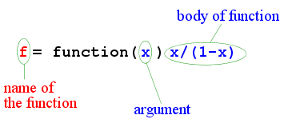
Functions in R
>g = function(x,y) (x+2*y)/3
>g(1,2)
>g(2,1)

Slide 33
Any question?
You may post your question(s) at the “Discussion Forum” maintained in the course Web page!

Slide 34
Just a minute to mark your attendance

